Slide 1

PROJECT PRESENTATION
Spam Mail Prediction using Machine Learning
Classifying emails as spam or ham from textual patterns, with 96.6% test accuracy
Vedant Patil
AI Advance Program
Naviotech Solutions

Slide 2
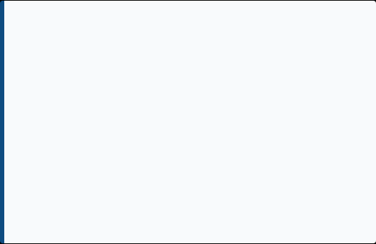
1. BACKGROUND
Introduction
Electronic mail is a cornerstone of digital communication, but it is heavily plagued by spam—bulk, unsolicited messages carrying cybersecurity risks and scams.
Problem Statement
Build a Machine Learning model that classifies an email as Malignant (Spam) or Benign (Ham) from raw text strings using Natural Language Processing (NLP), supporting faster, more consistent threat detection.
Traditional rule-based filters (like blocking specific keywords) are easily bypassed by spammers. A Machine Learning model can analyse textual patterns instantly, offering a fast and highly adaptable filtering mechanism.
2

Slide 3





2. GOALS & OBJECTIVES
Load and Explore Data
Import the standard 'mail_data.csv' text dataset and conduct exploratory analysis.
Preprocess and Clean
Handle null values and apply label encoding to the target categories (Spam=0, Ham=1).
Extract Numerical Features
Convert raw unstructured text into structured mathematical matrices using TF-IDF.
Train and Evaluate Model
Build a Logistic Regression classifier and test accuracy across train and test splits.
Build Predictive System
Construct a working pipeline to evaluate brand new, unseen patient/user emails.
3

Slide 4

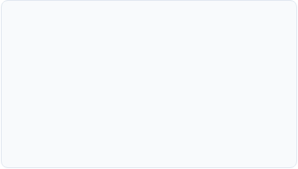
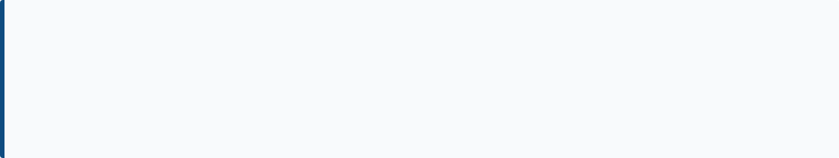
3. THE DATASET
Benchmark Spam Mail Dataset
5,572
2
0
TOTAL RECORDS
INPUT FEATURES
MISSING VALUES
Class Distribution
4,825 Ham | 747 Spam
*This imbalanced distribution accurately reflects real-world email traffic.
4

Slide 5
4. METHODOLOGY: DATA PREPARATION
•
1. Load Data: Utilized pandas (pd.read_csv) to ingest the raw file into a structured DataFrame.
•
2. Check Quality: Verified dataset integrity by handling null values, replacing them with empty strings ('') to prevent algorithm failure.
•
3. Split Features/Target: Isolated the raw message strings (X) from the descriptive categories (Y).
•
4. Label Encoding: Machine Learning requires numbers. Converted string labels to binary integers: Spam = 0 | Ham = 1
•
5. Train/Test Split: Divided data to ensure unbiased evaluation: 80% Training Data (4,457 records) 20% Testing Data (1,115 records)
5

Slide 6



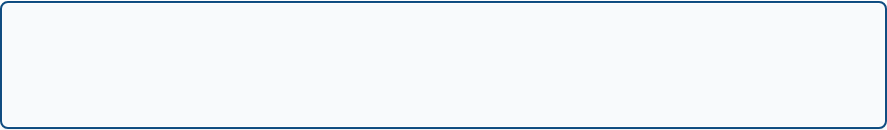
5. THE MODEL ARCHITECTURE
A lightweight, highly efficient machine learning pipeline built with Scikit-Learn.
1. Input Data
Raw text strings from email messages.
↓
2. TF-IDF Vectorizer
Transforms text into a numerical sparse matrix (extracting patterns).
↓
3. Logistic Regression
Learns the linear decision boundary between classes (Fast & Interpretable).
6
↓
4. Output Layer
Probability Score mapped to: Spam (0) or Ham (1).

Slide 7
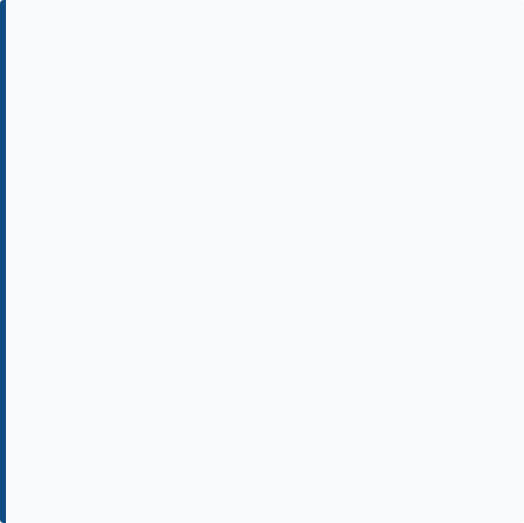
6. FEATURE EXTRACTION (TF-IDF)
Why Vectorization?
Machine learning models perform mathematical operations; they cannot read raw English text. We must convert words into meaningful numbers.
Parameters Used
•
min_df = 1
TF-IDF Explained
•
stop_words = 'english' (removes uninformative grammar words)
Term Frequency (TF): Measures how often a word appears in a specific email.
•
lowercase = True (ensures 'FREE' and 'free' are treated identically)
Inverse Document Frequency (IDF): Penalizes universally common words (like 'the', 'is') and gives high weight to rare, highly predictive words (like 'urgent', 'winner').
7

Slide 8
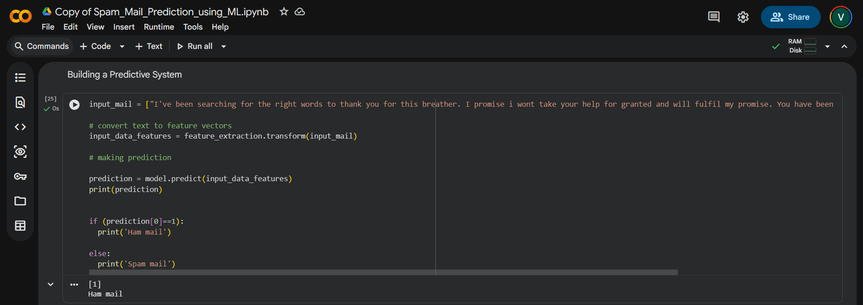
8. PREDICTIVE SYSTEM DEMONSTRATION
A new, unseen email text is processed, vectorized via TF-IDF, and passed to the trained Logistic Regression model for an instant prediction.
This confirms the trained model can serve as a real, working diagnostic aid.

Slide 9
9. SUMMARY & CONCLUSION
•
A Logistic Regression model was successfully trained on 5,572 real-world text records.
•
Achieved 96.6% accuracy on unseen test data, proving high reliability.
•
The model demonstrated excellent generalization, with training and test accuracy tracking almost identically (minimal overfitting).
•
Achieved Zero False Positives (no legitimate emails marked as spam), making it highly viable for enterprise deployment.
•
A working predictive system was built and validated, successfully classifying new text inputs instantly.
10

Slide 10

10. FUTURE SCOPE
•
Hyperparameter Tuning: Experiment with different n-gram ranges in TF-IDF to capture two-word phrases (e.g., "free money").
•
Model Comparison: Benchmark against Naive Bayes, Support Vector Machines (SVM), and Random Forests.
•
Deep Learning: Apply RNNs or LSTMs with Word2Vec to capture the semantic context of sentences, potentially catching the remaining 37 missed spam emails.
•
Web Deployment: Deploy as a web application (using Flask or Streamlit) for real-time clinical or enterprise use.
Thank You
11

